Slide 1
AWS EKS K8S DEPLOYMENT
Deploying K8S on AWS EKS through EKSCTL

Slide 2

Agenda
Project Plan
Ansible
Jenkins
K8S
EKSCTL
AWS EKS

Slide 3
Project Plan
Deploy K8S on AWS EKS using Jenkins and notify by slack.
- Firstly, We pushed the needed files to github for Jenkins to clone from it (k8s yaml, jenkinsfile, k8s service yaml, eksctl yaml and auto scaling group yaml)
- In order to deploy the project we create a Jenkins worker node on AWS EC2.
- We used ansible to run the needed dependences the project needs (java for Jenkins, install AWS CLI and created a directory for .aws to pass aws credential to it through ansible vault to encrypted, install docker cli and containerd, install kubectl and install eksctl )
- Configure Jenkins (add the worker node the EC2 instance, configure slack plugin and add the needed credentials and configure the pipeline by adding the github repo link )
- EKSCTL will be will responsible on creating the EKS resources on AWS.

Slide 4
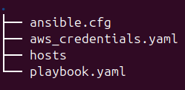
Ansible
We create for ansible four files :
- ansible.cfg (for the host key checking)
- hosts (which has the worker node information)
- aws credentials (which has been created with ansible vault to encrypt the credientials)
- playbook.yaml – The play book has the needed dependencies for installing java, aws cli, creating aws directory to pass aws credientials to it, installing eksctl, installing docker and installing k8s to be on Jenkins worker node (the EC2 Instance)

Slide 5
Jenkins
The pipeline of is configure with the below structure :
Prep stage : To clone the application for github repo.
Build stage : Where the application is build using docker.
and push to docker hub repo.
Deploy stage : first to clone the needed files from the repo where the eks, k8s and service yaml,
deploy the eks cluster, kubernetes deployment, load balancer service and auto scaling group.
- Post stage : To notify slack in case the pipeline succeed or failed.

Slide 6
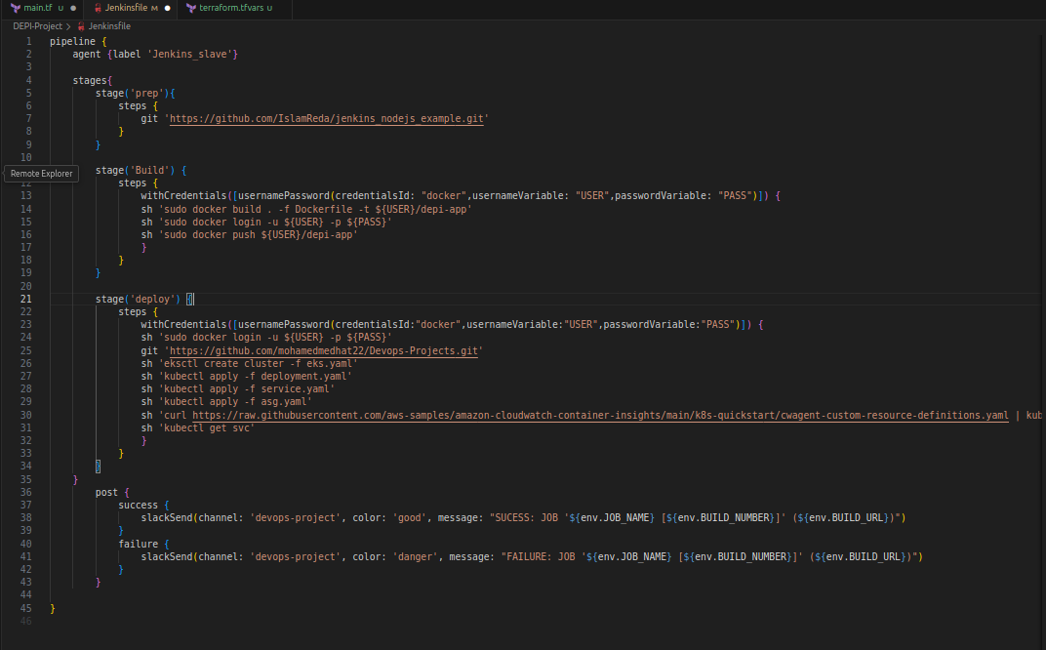
Jenkins

Slide 7
K8S
The yaml files needed in this deployment :
Deployment : Where the pods get created using the image of the app that has been build before, where we have to replica sets and application exposed on port 3000.
Service : Where the load balancer on AWS is created to access the app through one public ip.
Auto scaling group : To horizontal auto scale the instances when the CPU of the instance is utilized to 50%.

Slide 8
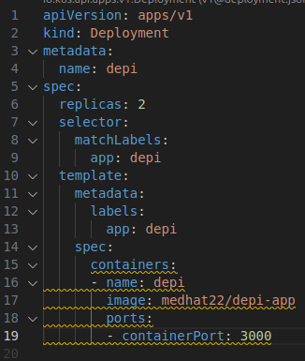
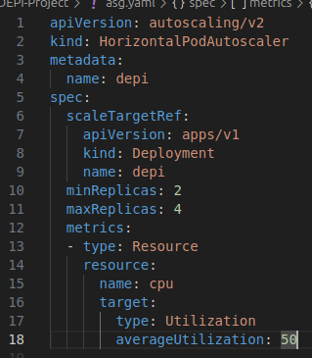
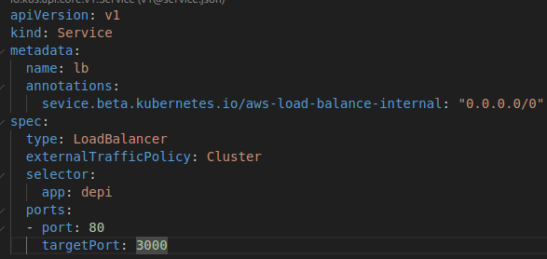
K8S
Deployment.yaml Service.yaml asg.yaml

Slide 9
EKSCTL
EKSCTL is used for creating the EKS resources on AWS.
Is created in the declarative way through yaml file.
Where the nodes is managed, we created 2 as the desired, min. 2 and max 4.
We allowed the SSH access to open port 22 and pass the private key.
We add an IAM role to allow the auto scaling.

Slide 10
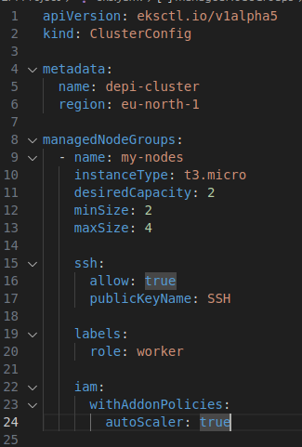
EKSCTL

Slide 11
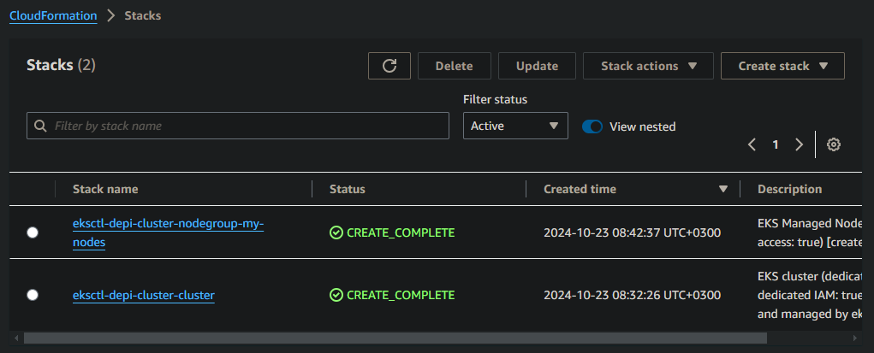
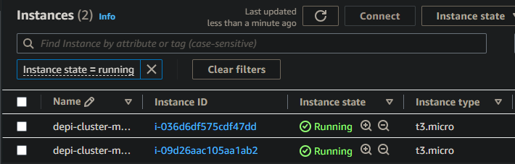
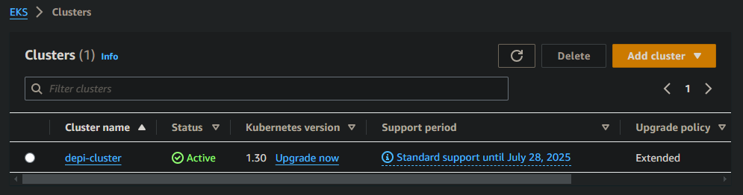
AWS EKS

Slide 12
The END

